Slide 1



Aerospace Alloy Advancements
Lina Salsabila Youssfi
Dr. Timothy Takahashi
School of Engineering, Matter, Transport and Energy

Slide 2
Overview
  Aircraft Timeline (1900s to Present)
  Wright Flyer CAD Model
  Modern Plane Parts & Functions
  Airplane Alloys and Properties
  Results & Significance
  Acknowledgements

Slide 3
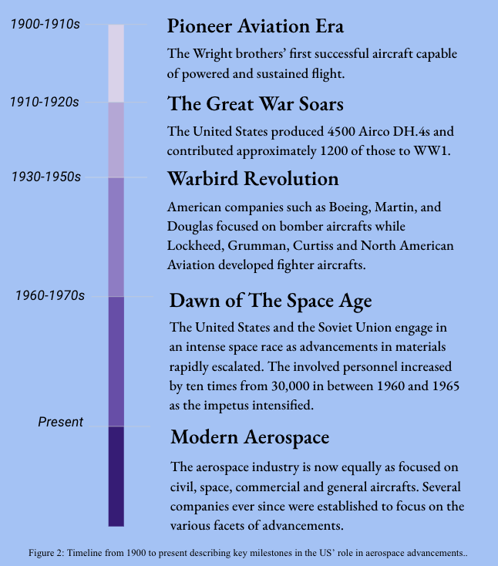
Airplane Development Timeline (1900's to Present)

Slide 4
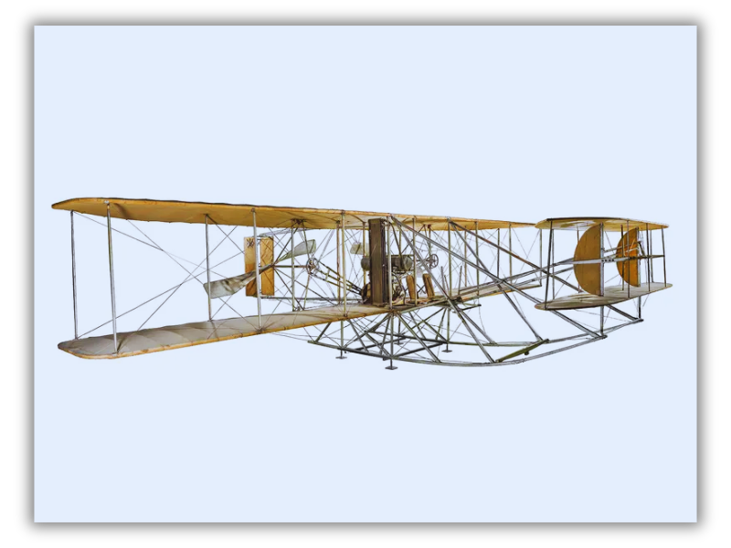
Simplified CAD Model of Wright Flyer
https://www.smithsonianmag.com/smithsonian-institution/after-wright-brothers-took-flight-they-built-worlds-first-military-airplane-180980807/

Slide 5
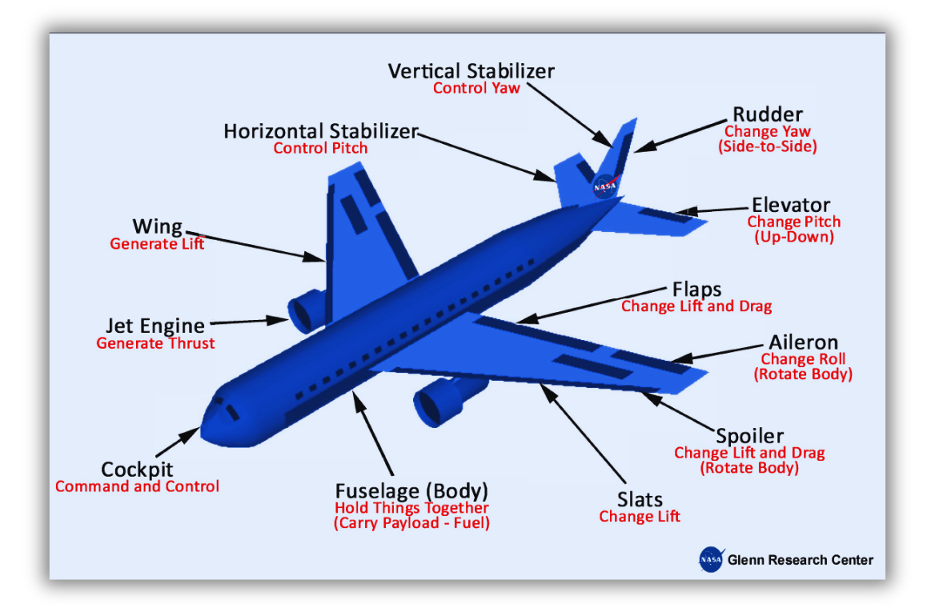
Overview of Modern Airplane Parts & Functions

Slide 6
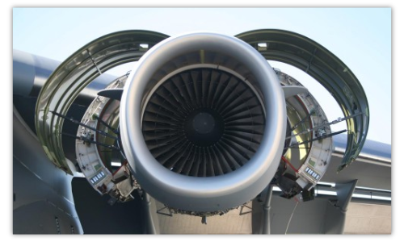
Getting to Know Metals, Alloys & Their Properties
Aluminum & Alloys
Characteristics:
  Lightweight, corrosion-resistant, malleable.
Composition:
  90-94% Aluminum, X% Zinc, Copper, Magnesium...
Use:
  Impellers, engine pistons, compressor rings.
https://alloysintl.com/aluminum-flying-high/why-aluminum-alloy-2024-is-the-best-material-for-aircraft

Slide 7
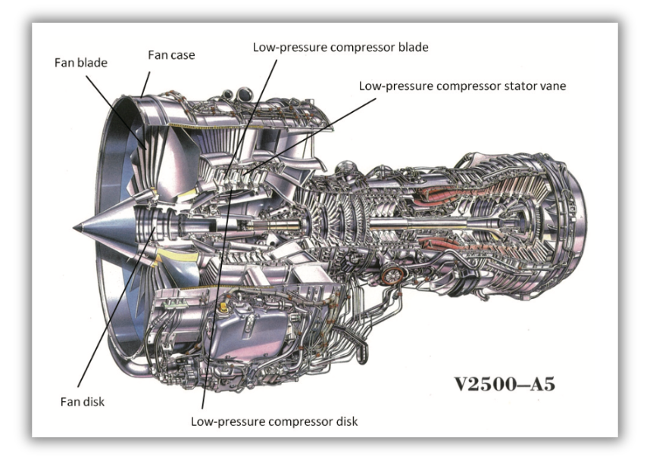
Getting to Know Metals, Alloys & Their Properties
Titanium & Alloys
Characteristics:
  Low modulus of elasticity, heat treatable, strong.
Composition:
  90-94% Titanium, X% Aluminum, Vanadium, Copper...
Use:
  Rotors, hydraulic system, compressor blades and nacelles
https://www.nipponsteel.com/en/tech/report/nssmc/pdf/106-05.pdf

Slide 8
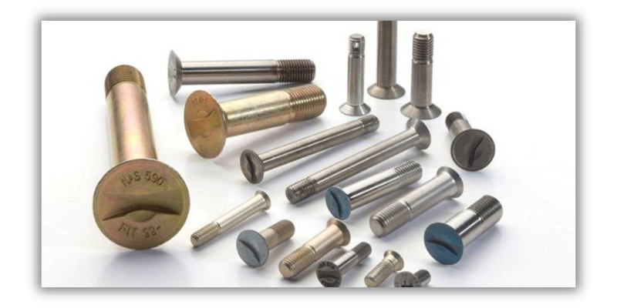
Getting to Know Metals, Alloys & Their Properties
Nickel & Alloys:
Characteristics:
  Corrosion and oxidation resistant, high tensile strength
Composition:
  ~70% Titanium, X% Chromium, Iron, Copper...
Use:
  Exhaust valves, combustion chambers, gas turbines, fasteners...
https://waykenrm.com/blogs/aerospace-fasteners/

Slide 9
Results and Significance
  Understanding the relationship between metal composition, part location and function within the aircraft.
  Cementing the importance of material analysis for respective allocation.
  Highlighting the many factors that come into play when choosing materials.
  Making the foundational knowledge of these topics more widespread and accessible.
  Ensuring FAA regulatory compliance in aircraft construction and hence passenger safety.
  Assessing and improving environmental impacts from production all the way to disposal.

Slide 10
Acknowledgements
  Dr. Timothy Takahashi, my Space Grant mentor.
  Desiree Crawl, ASU Space Grant coordinator.
  The Fulton Schools of Engineering staff.
  The Arizona Space Grant team.
  The Arizona State University Space Grant team.

